Slide 1




ECOSMART SYSTEM
Our project aims to protect the earth via smart waste management and prevent forest fire.
The main vision is to create a smart, sustainable, and citizen-friendly waste management ecosystem that incentivizes proper waste segregation, optimizes municipal operations, and contributes to environmental conservation .
This collaborates with an Advanced Forest Fire Detection and prevention mechanism that uses satellite imagery and AI-powered analysis to detect and monitor forest fires in real-time.

Slide 2

Scope
Public Sector
Municipal Sector
Technology
Geographical Rollout
Detect and monitor forest fire in real time
Provides web interface
Supports emergency response, research and land management
Geographic Intelligence
Deterministic Results

Slide 3

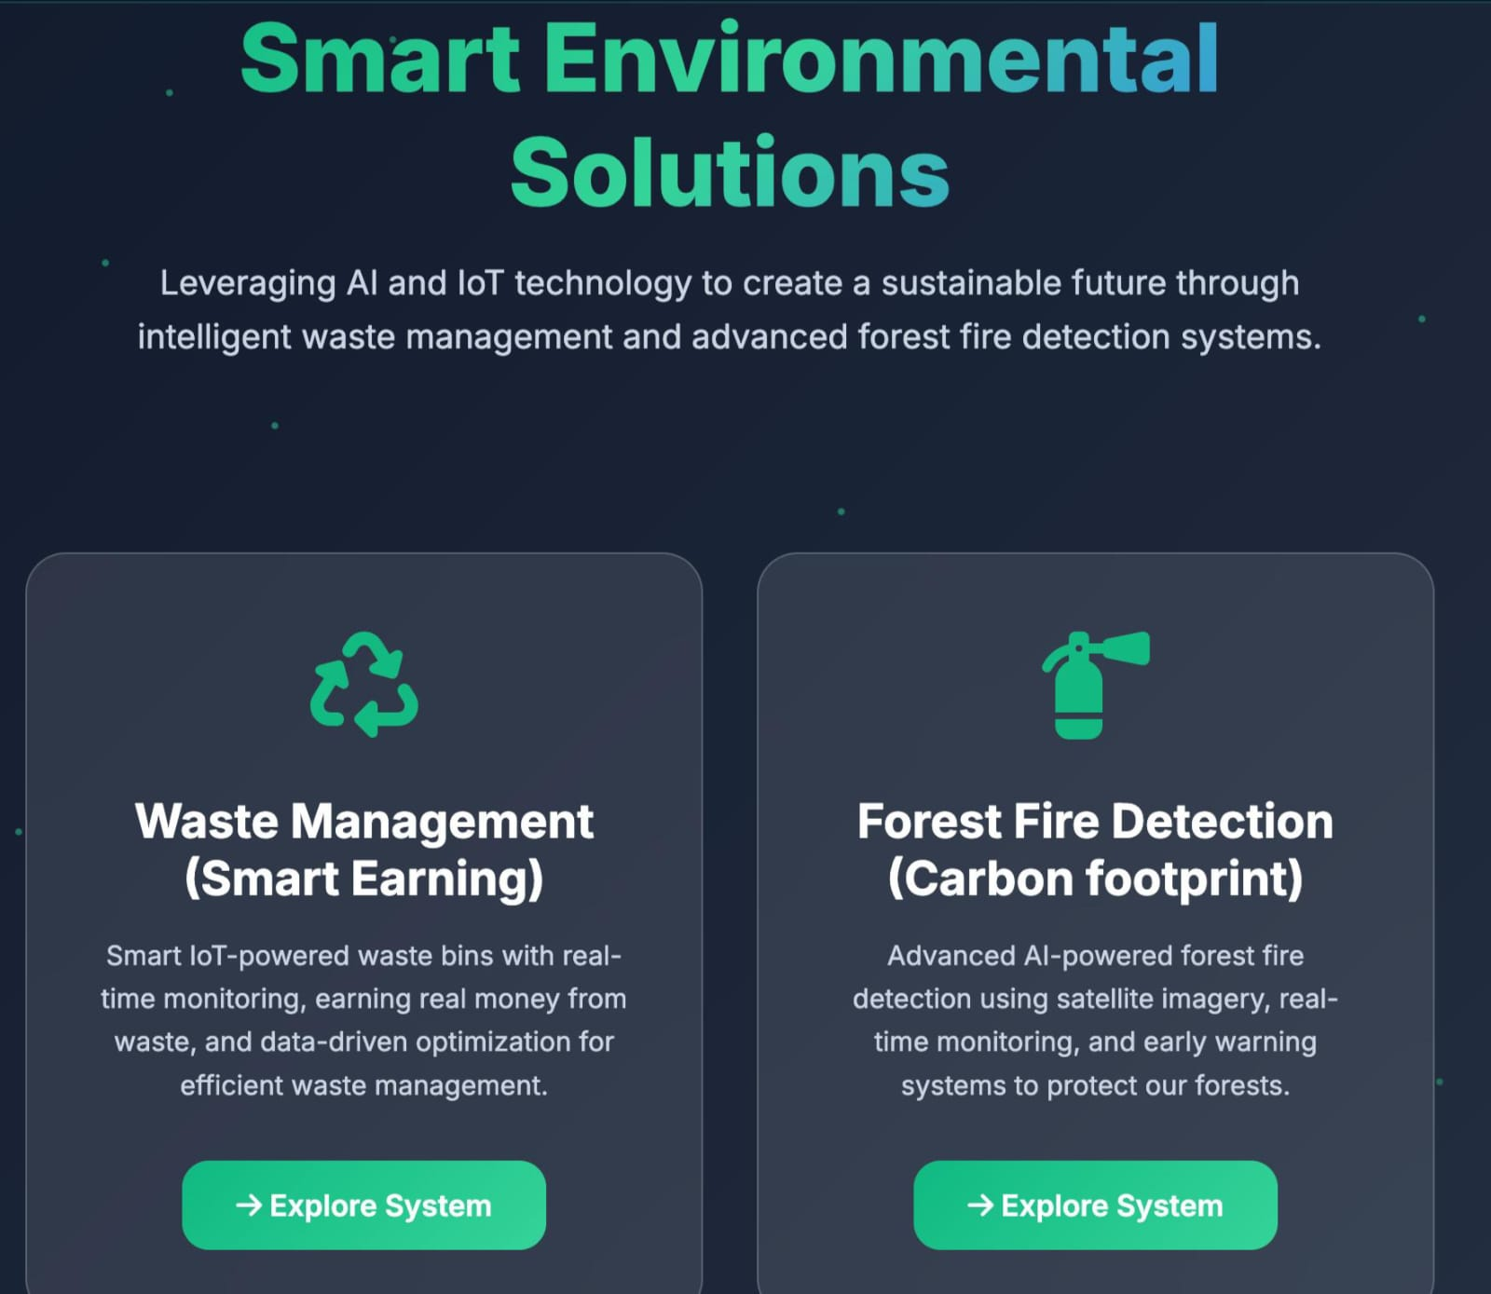
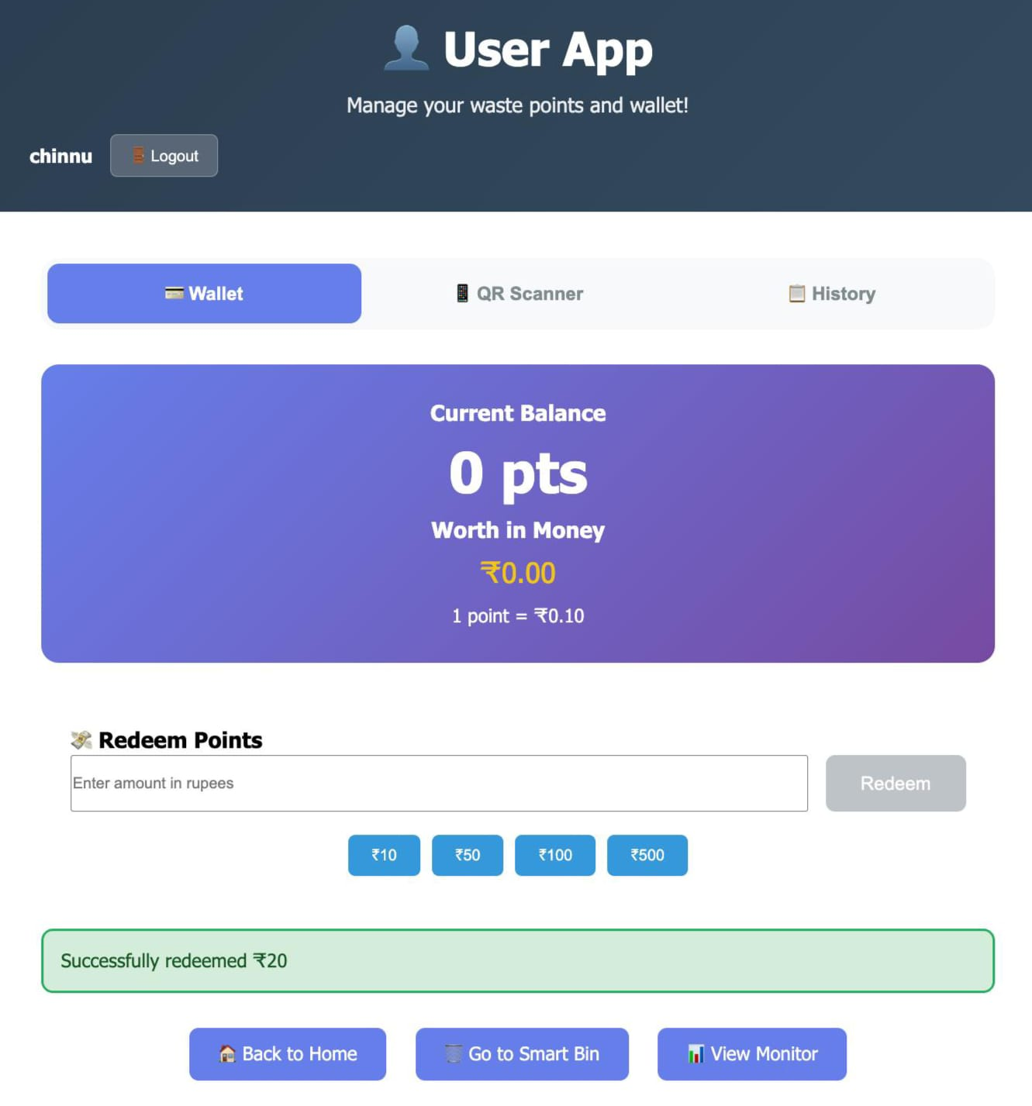
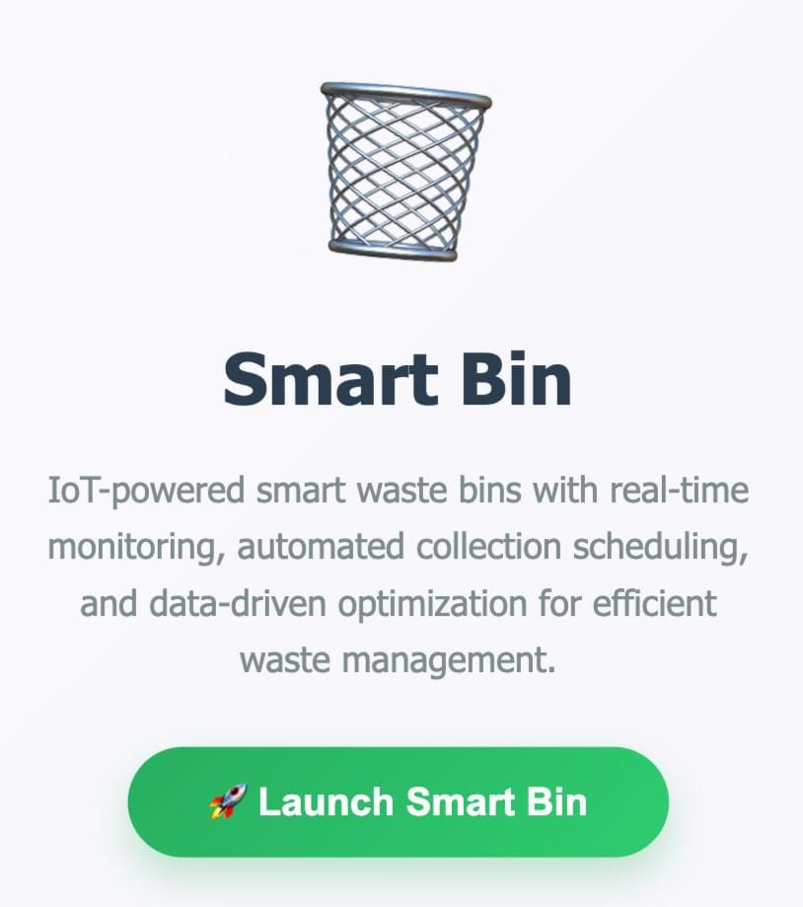
Smart Waste management
Intelligent Waste Management
User-friendly Mobile App
Advanced Sensor Technology
Real-time waste monitoring
Seamless interaction experience
Optimized collection process
3

Slide 4
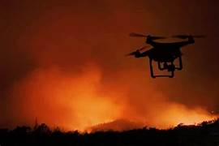
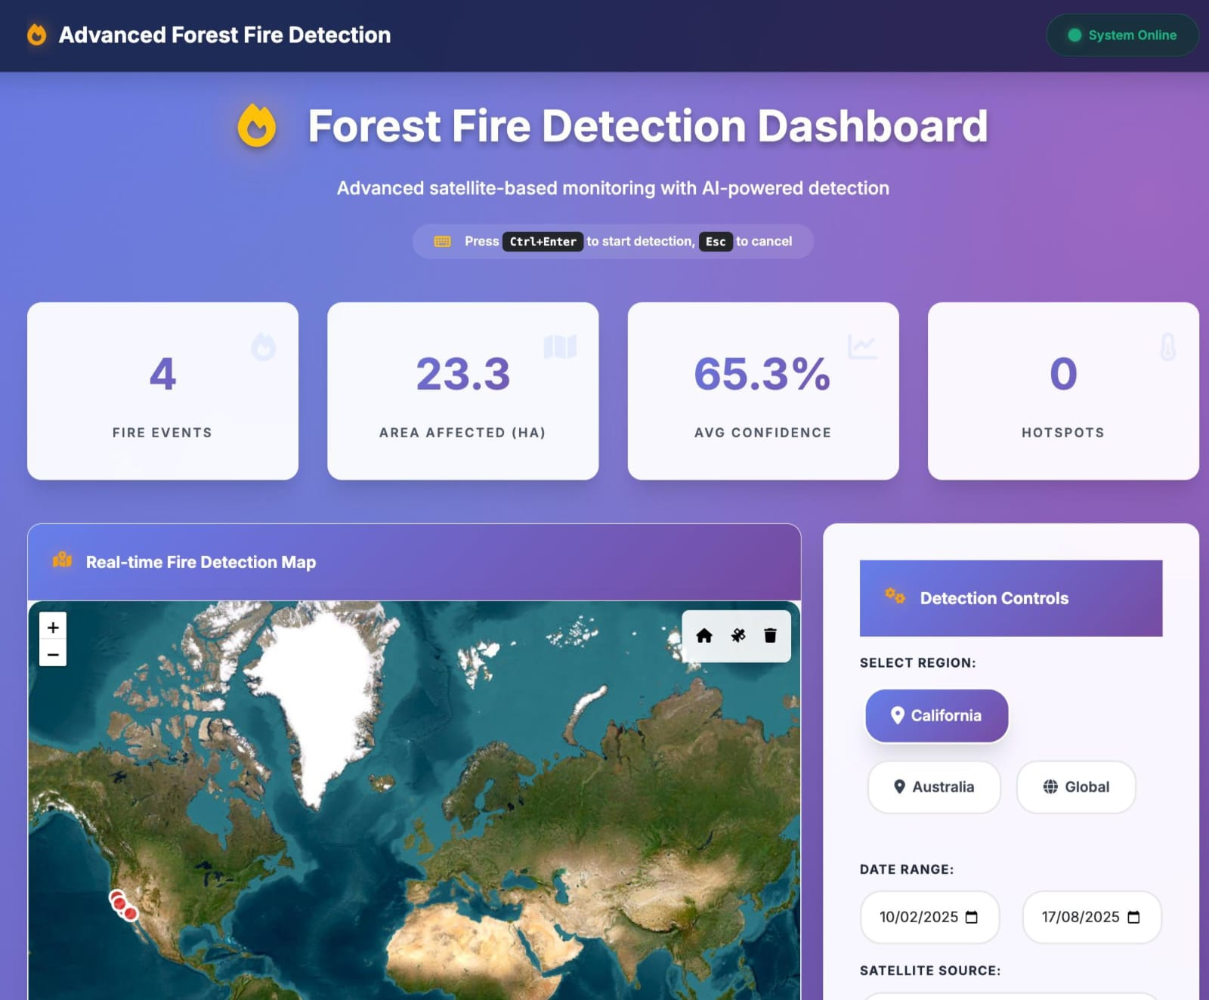
Forest fire detection and prevention
Detects and monitors forest fire in real time – It helps to detect the forest fire beforehanded so that it can be prevented.
3

Slide 5


System Architecture
1
Smart bins utilize sensors and IoT technology for efficient waste management
2
The reward system encourages community participation and promotes recycling initiatives
3
Government integration enhances transparency and accountability in waste management processes
4
Interactive map, real-time dashboard, region/date/satellite selection, cloud cover control, modern UI.
5
RESTful API endpoints, background tasks, deterministic fire detection algorithms, mock data generation, CORS support.
2

Slide 6

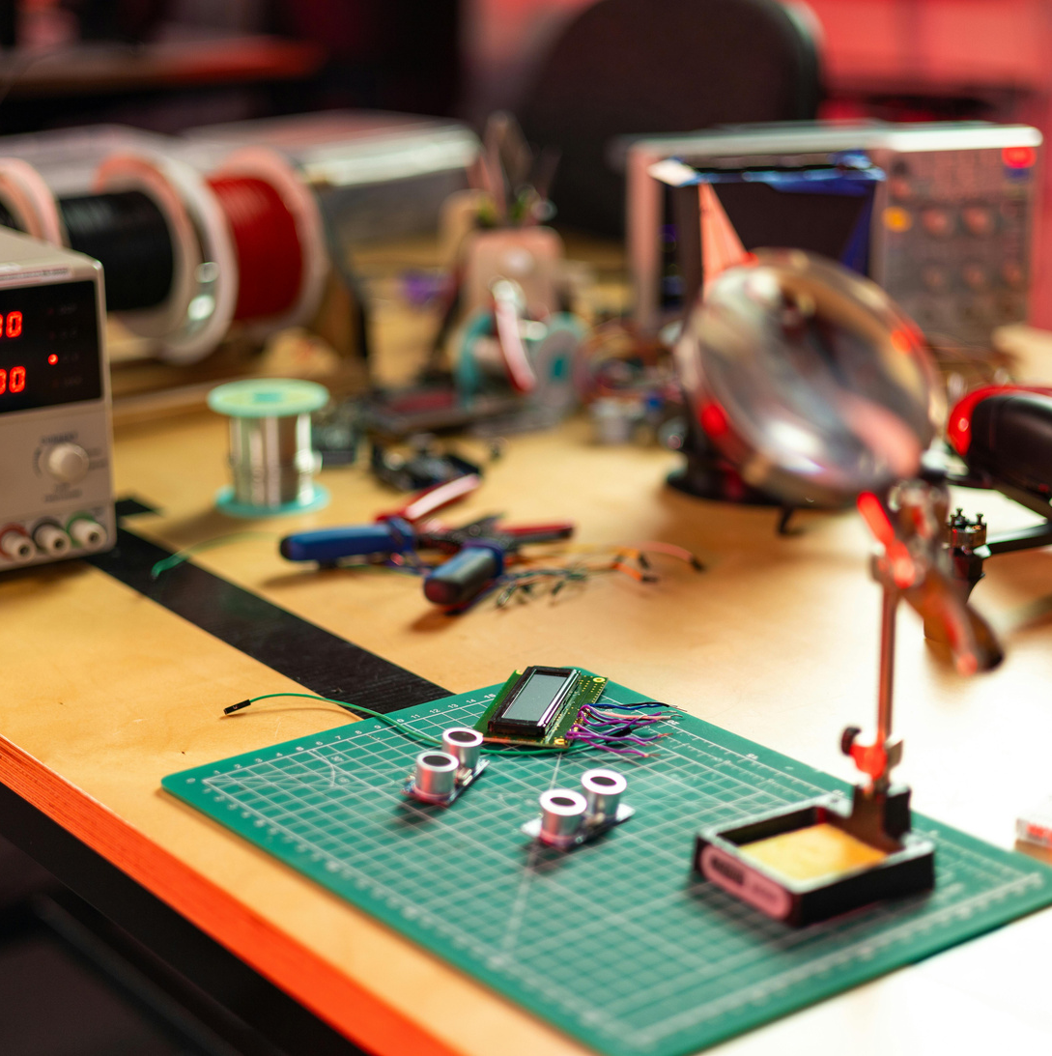
Hardware Components
Weight Sensors: Load cells with ±0.1 kg precision for accurate measurement of waste quantity.
Waste Classification: AI-powered image recognition, spectral sensors for material detection .
IoT Connectivity: 4G/5G modules or Wi-Fi support for seamless data transmission.
Payment & Reward Interface: NFC rea QR code scanner for user identification and reward redemption.
User Interface: Integrated LCD display with audio feedback for real-time interaction.
Security Features: Tamper-proof construction and GPS tracking for location monitoring.
Power Management: Solar panels with battery backup for uninterrupted operation.
4

Slide 7


Software Components
Edge AI Processing: On-device waste classification for faster and more efficient operations.
Cloud Data Transmission: Real-time updates to the central municipal dashboard and mobile applications.
Mobile Application Integration: Secure user authentication and profile management.
Reward Calculation Engine: Dynamic pricing algorithms to determine rewards based on waste type and quantity.
Web interface : HTML5, CSS3, JavaScript, Bootstrap 5, Leaflet.js
API Server : FastAPI (Python), Uvicorn
5

Slide 8


Municipal Dashboard
Real-time monitoring for efficient waste management
1
Data visualization enhances understanding of waste patterns and trends.
2
Collection schedules optimize routes and improve operational efficiency.
3
User engagement encourages community participation in waste reduction efforts.
6

Slide 9



Smart Connectivity Solutions
Integrating IoT for efficient waste management and real-time monitoring
The Smart Incentive-Based Waste Management System utilizes IoT for seamless connectivity, enabling real-time data exchange and improving efficiency across waste management operations.
User-Friendly Waste Management :
The mobile app enhances user engagement by providing real-time waste tracking and reward notifications, promoting sustainable habits and efficient waste management.
7

Slide 10
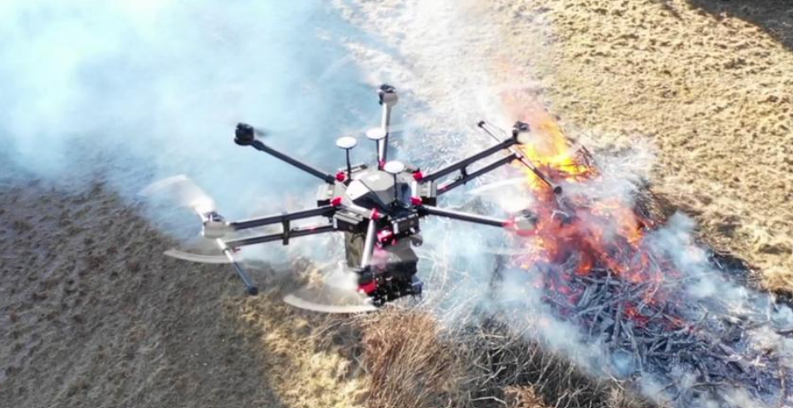
Data Flow of forest fire prevention
1. User Input
2. API Request
3. Background Processing
4. Detection Analysis
5. Results
6. Frontend Display
Key Algorithms: - Spectral Indices: NBR, dNBR, BAI, NDVI - Thermal Analysis: Brightness temperature and FRP - Geographic Logic: Land vs water detection - Confidence Scoring: Based on satellite quality and conditions
7

Slide 11

Project Highlights
Deterministic accuracy, modern interface, smart detection, robust backend, scalable architecture
2. Fixed accuracy issues, enhanced UI/UX, reliable API, comprehensive testing
7

Slide 12
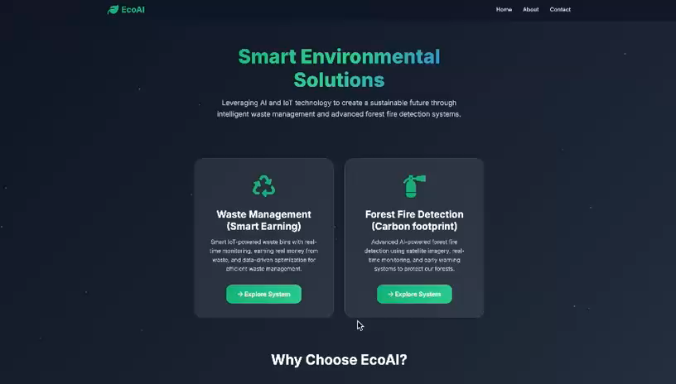
System video demonstration

Slide 13

CONCLUSION
This project offers a scalable, eco-friendly, and economically viable solution for protection of the earth. By integrating IoT, AI, and blockchain-based rewards, it fosters community participation, improves operational efficiency, and supports environmental sustainability.
9

